Slide 1
CPSC 131
Data Structures
AVL Trees

Slide 2
Tree Height and BST Issue

Slide 3
Depth
Depth of a node: number of ancestors (between the node and the root)
Root has depth 0
Depth of p’s node is recursively defined:
if (p.isRoot()) return 0; // root has depth 0
else return 1 + depth(p.parent()); // 1 + (depth of parent)
0
map<int, string> ds;
ds[5] = "Monday";
ds[15] = "Tuesday";
ds[25] = "Wednesday";
ds[11] = "Thursday";
5
What is the depth at each node?
1
15
2
2
11
25

Slide 4
Height
Height of a node p in a tree T is defined recursively:
If p is the external node, then the height of p is 0
Otherwise, the height of p is 1 + the maximum height of children of p
Height of a tree == maximum depth of its external nodes
Height of a tree T is the height of the root of T
2
map<int, string> ds;
ds[5] = "Monday";
ds[15] = "Tuesday";
ds[25] = "Wednesday";
ds[11] = "Thursday";
5
What is the height at each node?
1
15
0
0
11
25

Slide 5
Issue with Binary Search Tree Performance
A binary search tree (BST) with n items
The space used is O(n)
Methods find, insert and erase take O(height) time
height = n, worst case ➔ long skinny tree
Example: insert 2, 4, 6, 8, 10 into a BST
What is the issue? Lack of balance!
2
long skinny tree
4
6
8
10
height = log n, best case ➔ balanced tree
balanced tree

Slide 6
Perfect Binary Search Tree
Height h | Number of Nodes n
1 | 1
2 | 3
3 | 7
4 | 15
… | …
h | 2^{h} - 1

Slide 7

Rice and chessboard

Slide 8
http://www.axxonsoft.com/integrated_security_solutions/lpr/

Slide 9

http://www.axxonsoft.com/integrated_security_solutions/lpr/

Slide 10
Self-Balancing Trees
Always ensure that BST is balanced
IF an insert (or delete) makes the BST not balanced, then rearrange the nodes so that the tree stays balanced
Challenge: the node rearrangement should not take too long!
Otherwise, lose the search speed benefit
Node rearrangement still keeps the same nodes in sorted order but in a different layout
Many types of balanced trees
AVL trees
The first self-balancing tree
Invented in 1962 by Russian mathematicians Georgy Adelson-Velsky and Evgenii Landis
Red-Black trees
Splay trees
(2,4) trees

Slide 11
AVL Trees
AVL trees are height-balanced binary search trees such that for every internal node v of T, the heights of left and right subtrees of v can differ by at most 1
H = 1 + max of height(left subtree) and height(right subtree)
Balance factor calculated at each node
BF = height(left subtree) – height(right subtree)
3
-1
44
1
-1
2
1
17
78
0
32
0
1
50
1
0
88
0
0
48
0
Treat an empty tree (nullptr) as height = -1
“good enough” balance but not perfectly balanced

Slide 12

Insertion
Inserting a new key-value same as in a binary search tree
Always done by expanding an external node.
Example: insert key 54
44
44
Balance factor:
2 – 0 = 2
No longer AVL!
17
78
17
78
2
0
32
50
88
32
50
88
0
1
48
62
48
62
0
54
before insertion
after insertion

Slide 13
Trinode Restructuring
Focus on only three nodes
44
17
78
z (first imbalanced node)
y (child of z)
2
0
32
50
88
0
1
48
62
0
x (child of y)
54
newly inserted node
4 combinations: Y and X can be left/right child of Z

Slide 14
Trinode Restructuring
4 combinations: Y and X can be left/right child of Z
Z
Z
Z
Z
Y
Y
Y
Y
X
X
X
X

Slide 15
Insert with restructuring
Insert as usual for a BST
At an external node
Check for imbalance starting from new external node, up to root
If no imbalance, then done
Identify the three “problem nodes”
First imbalanced node (call this z)
“Tallest” child of x (call this y)
“Tallest” child of y (call this x)
Refer to trinode restructuring handout and identify which rotation to do
Single left rotation,
Single right rotation,
Double left rotation, or
Double right rotation
Perform the rotation below z
Keep the rest of the tree as it is

Slide 16
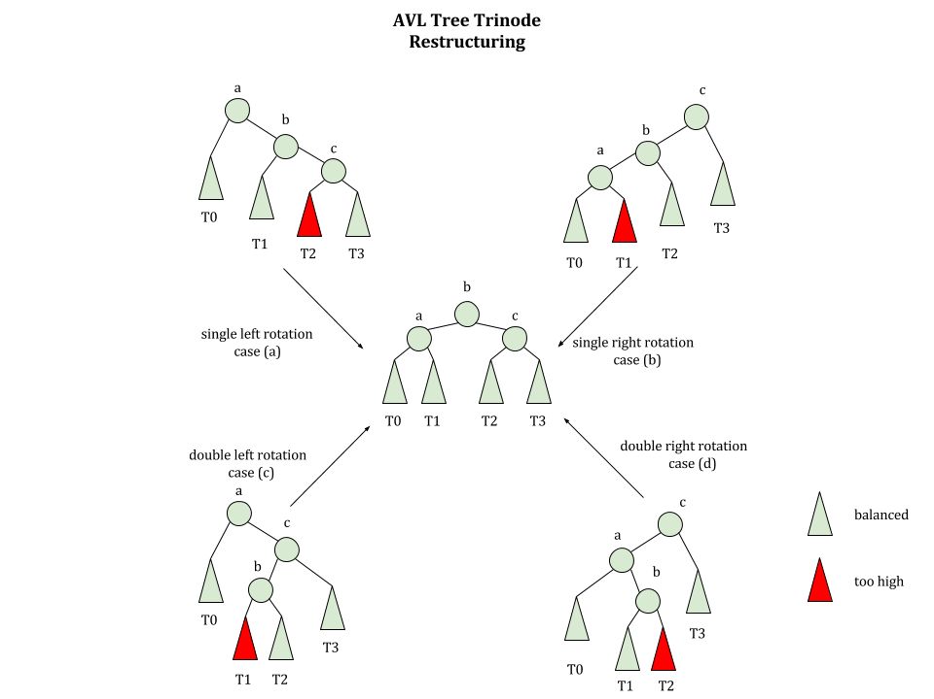

Slide 17
Restructuring – as Single Rotations

Slide 18
Restructuring – as Double Rotations
zyBook Annimations

Slide 19
Trinode Restructuring (cont)
Focus on only three nodes
44
z (first imbalanced node)
44
17
78
y (child of z)
rotate
2
0
17
62
32
50
88
0
1
32
50
78
48
62
0
48
54
88
x (child of y)
54
newly inserted node
after rotation (balanced)

Slide 20
Interactive visualization
https://visualgo.net/en/bst

Slide 21
Removal
Removal begins as in a binary search tree, which means the node removed will become an empty external node. Its parent, w, may cause an imbalance
Example:
44
44
17
62
17
62
imbalance
32
50
78
50
78
48
54
88
48
54
88
before deletion of 32
after deletion

Slide 22
Rebalancing after a Removal
Let z be the first unbalanced node encountered while travelling up the tree from w. Also, let y be the child of z with the larger height, and let x be the child of y with the larger height
We perform restructure(x) to restore balance at z
If this restructuring upsets the balance of another node higher in the tree, we would continue checking for balance until the root of T is reached
a=z
imbalance
62
44
rotate
44
78
w
17
62
b=y
c=x
17
50
88
50
78
48
54
48
54
88

Slide 23
Time complexity of insert
Insert operations | BST | AVL
Insert as external node | O(height)
Check for balance (at every node from new node up to root) | -
Trinode restructuring | -
Total in worst-case | O(height) = O(n)
O(height)
O(height)
O(1)
O(height)
O(height) = O(1og n)

Slide 24
Height of an AVL Tree
If an AVL tree contains n nodes (i.e., n key-value pairs), what is its height?
Can show that:
The maximum height of an AVL tree storing n keys is 2*log(n) = O(log n).

Slide 25
AVL Tree Performance
a single restructure takes O(1) time
using a linked-structure binary tree
find takes O(log n) time
height of tree is O(log n), no restructures needed
put takes O(log n) time
initial find is O(log n)
Restructuring up the tree, maintaining heights is O(log n)
erase takes O(log n) time
initial find is O(log n)
Restructuring up the tree, maintaining heights is O(log n)

